Slide 1
Languages and Compilers
(SProg og Oversættere)
Language Design
and Control structures

Slide 2
Language Design and control structures
  Language Design Criteria
  Relate language design criterial to the following consepts
  Evaluation of expressions
  Explicit vs. implicit sequence control
  Loop constructs
  Subprogram
  Parameter mechanisms

Slide 3
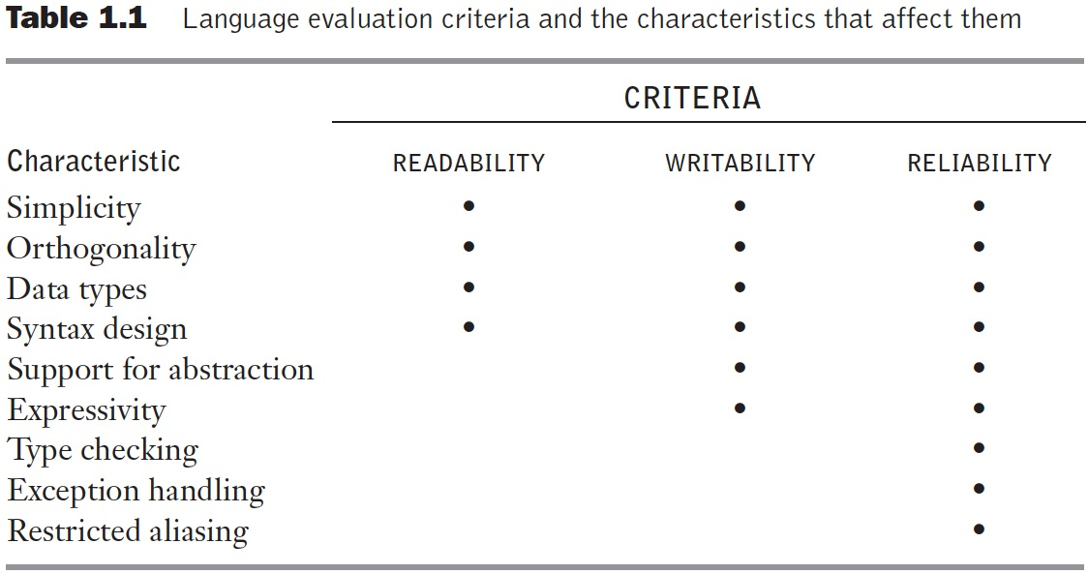
Table 1.1 Language evaluation criteria and the characteristics that affect them
Notes:
Orthogonality
A relatively small set of primitive constructs can be combined in a relatively small number of ways
Every possible combination is legal
Lack of orthogonality leads to exceptions to rules
Expressivity:
In computer science, the expressive power (also called expressiveness or expressivity) of a language is the breadth of ideas that can be represented and communicated in that language. The more expressive a language is, the greater the variety and quantity of ideas it can be used to represent.
Restricted aliasing:
Ved computing beskriver aliasing en situation, hvor en dataplacering i hukommelsen kan fås via forskellige symbolnavne i programmet. Således ændrer dataene under ét navn implicit de værdier, der er knyttet til alle aliasede navne, hvilket muligvis ikke forventes af programmereren

Slide 4
Sequence control
Implicit and explicit sequence control
  Expressions
    Precedence rules
    Associativity
    Operand evaluation order
  Statements
    Sequence
    Conditionals
    Loop constructs
    unstructured vs. structured sequence control
  Subprograms
    Parameter mechanisms
Notes:
• Implicit sequence-control structures: These are defined by language to be in effect ’un1es'smodified by the programmer through some explicit structure. For example, most languages define the physical sequence of statements in a program as controlling the sequence in which statements are executed, unless modified by an explicit sequence-control statement.
• Explicit sequence-control structure These are the sequence-control structures that the programmer may optionally use to modify the implicit sequence of operations defined by the language.
Expressions:
I datalogi er et udtryk en syntaktisk enhed på et programmeringssprog, der kan evalueres for at bestemme dets værdi. Det er en kombination af en eller flere konstanter, variabler, funktioner og operatører, som programmeringssproget fortolker og beregner for at producere en anden værdi.
Statements:
In computer programming, a statement is a syntactic unit of an imperative programming language that expresses some action to be carried out. A program written in such a language is formed by a sequence of one or more statements. A statement may have internal components (e.g., expressions).
Subprograms:
Methoder/funktioner/procedure der udføre en mindre opgave for en større del fx. Forskellige måder at overføre parametre på

Slide 5
Expression Evaluation
Determined by
  operator evaluation order
  operand evaluation order
Operators:
  Most operators are either infix or prefix (some languages have postfix)
  Order of evaluation determined by operator precedence and associativity
Notes:
”*” over ”+”? Fx ”=”
Operand: ”left to right”? Eller andet? ”Assiosivirty” gør det en forskel?
Infix: i mellem
Prefix: før
Postfix: efter

Slide 6
Example
What is the result for:
  3 + 4 * 5 + 6
Possible answers:
  41 = ((3 + 4) * 5) + 6
  47 = 3 + (4 * (5 + 6))
  29 = (3 + (4 * 5)) + 6 = 3 + ((4 * 5) + 6)
  77 = (3 + 4) * (5 + 6)
In most language, 3 + 4 * 5 + 6 = 29
… but it depends on the precedence of operators
Notes:
Normal math, gør det kort

Slide 7
An Ambiguous Expression Grammar
How to parse 3+4*5?
<expr> → <expr> <op> <expr> | const
<op> → + | *
<expr>
<expr>
<expr>
<op>
<expr>
<op>
<expr>
<op>
<expr>
<expr>
<op>
<expr>
<expr>
<op>
<expr>
const
+
const
*
const
const
+
const
*
const
3 4 5 3 4 5
Notes:
Kan lave begge, da <expr> er der to gange i samme udtryk

Slide 8
Expressing Precedence in grammar
We can use the parse tree to indicate precedence levels of the operators
<expr> → <expr> + <term> | <term>
<term> → <term> * const | const
In LALR parsers we can specify
Precedence which translates into
Solving shift-reduce conflicts
Note in LL(1) parsers we have to use
Left recursion elimination
<expr>
<expr>
+
<term>
Expr → Term Expr1 .
Expr1 → + Term Expr1
| .
Term → const Term1 .
Term1 →* const Term1
| .
<term>
<term>
*
const
const
const
Notes:
Shift-reduce: https://www.gnu.org/software/bison/manual/html_node/Shift_002fReduce.html
Right recursion: Left recursion is eliminated by converting the grammar into a right recursive grammar.

Slide 9
Operand Evaluation Order
Example:
A := 5;
f(x) = {A := x+x; return x};
B := A + f(A);
What is the value of B?
10 or 15?
Notes:
15

Slide 10
Solution to Operand Evaluation Order
Disallow all side-effects in expressions but allow in statements
  Problem: not applicable in languages with nesting of expressions and statements
Fix order of evaluation
  SML does this – left to right
  Problem: makes some compiler optimizations hard or impossible
Leave it to the programmer to be sure the order doesn’t matter
  Problem: error prone
  Fortress: Parallel evaluation unless specified to be sequential
Notes:
Side-effects: In computer science, an operation, function or expression is said to have a side effect if it modifies some state variable value(s) outside its local environment, that is to say has an observable effect besides returning a value (the main effect) to the invoker of the operation.
https://en.wikipedia.org/wiki/Side_effect_(computer_science)

Slide 11
Control of Statement Execution
Sequential
Conditional Selection
Looping Construct
Must have all three to provide full power of a Computing Machine

Slide 12
For-loops
Controlled by loop variable of scalar type with bounds and increment size
Scope of loop variable?
  Extent beyond loop?
  Within loop?
When are loop parameters calculated?
  Once at start
  At beginning of each pass
Notes:
Scalar: A scalar is a "single" value - integer, boolean, perhaps a string - while a compound is made up of multiple scalars (and possibly references to other compounds). "Scalar" is used in contexts where the relevant distinction is between single/simple/atomic values and compound values.

Slide 13
Logic-Test Iterators
While-loops
  Test performed before entry to loop
repeat…until and do…while
  Test performed at end of loop
  Loop always executed at least once
Design Issues:
  1. Pretest or posttest?
  2. Should this be a special case of the counting loop statement (or a separate statement)?

Slide 14
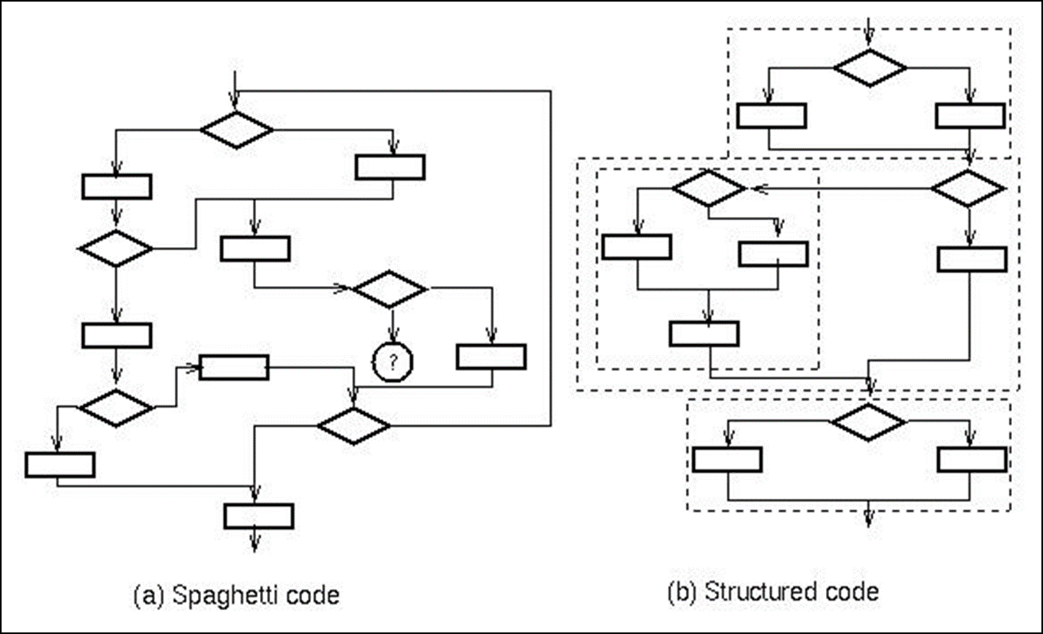

Gotos
Requires notion of program point
Transfers execution to given program point
Basic construct in machine language
Implements loops

Slide 15
Exceptions: Structured Exit
Terminate part of computation
  Jump out of construct
  Pass data as part of jump
  Return to most recent site set up to handle exception
  Unnecessary activation records may be deallocated
    May need to free heap space, other resources
Two main language constructs
  Declaration to establish exception handler
  Statement or expression to raise or throw exception
Often used for unusual or exceptional condition, but not necessarily.
Notes:
Bobble up:

Slide 16
Subprograms
A subprogram has a single entry point
The caller is (normally) suspended during execution of the called subprogram
Control (normally) returns to the caller when the called subprogram’s execution terminates
Functions or Procedures?
Procedures provide user-defined statements
    Abstractions over statements
Functions provide user-defined operators
    Abstractions over expressions
Methods used for both functions and procedures
Notes:
Funktioner og procedure fx
Funktioner returnere en værdi eller noget lignende
Procedure udføre en række intruktioner

Slide 17
Subprogram Parameters
Formal parameters: names (and types) of arguments to the subprogram used in defining the subprogram body
Actual parameters: arguments supplied for formal parameters when subprogram is called
Actual/Formal Parameter Correspondence:
  attributes of variables are used to exchange information
    Name – Call-by-name
    Memory Location – Call-by reference
    Value
      Call-by-value (one way from actual to formal parameter)
      Call-by-value-result (two ways between actual and formal parameter)
      Call-by-result (one way from formal to actual parameter)
Notes:
Måske en figur:
https://www.cse.iitd.ac.in/~saroj/LFP/LFP_2013/sml6.pdf
Call-by-name:
Call-by-reference: Pointer i C fx, værdien følger med ud
Call-by-value: Overføre bare selve værdien, ændre ikke den originale
Call-by-value-result: A ParameterPassing mode, used in AdaLanguage to handle "IN OUT" parameters. In CallByValueResult, the actual parameter supplied by the caller is copied into the callee's formal parameter; the function is run; and the (possibly modified) formal parameter is then copied back to the caller.
Call-by-result: https://www.youtube.com/watch?v=frFBNwEIAcA

Slide 18
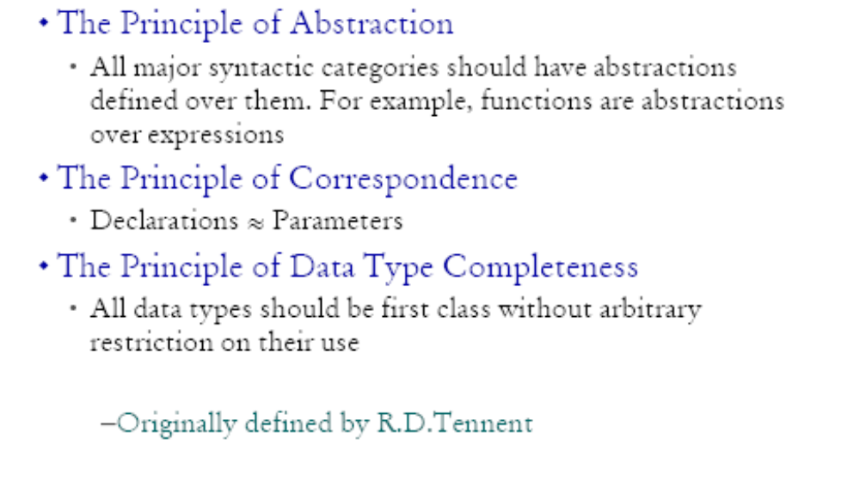
Tennent’s Language Design principles

Slide 19
Example of missing correspondence
In Pascal:
procedure inc(var i : integer);
begin
i := i + 1
end;
var x : integer;
begin
x := 1;
inc(x);
writeln(x);
end
No corresponding declaration
However C has correspondence
void inc(int *i) {
*i = *i + 1;
}
int x = 1;
inc(&x);
printf("%d", x);
int x = 1;
{
int *i = &x;
*i = *i + 1;
}
printf("%d", x);

